Slide 1

A short history of keyboards
and why we need better ones
By Riaan Cornelius
@RiaanCornelius

Slide 2
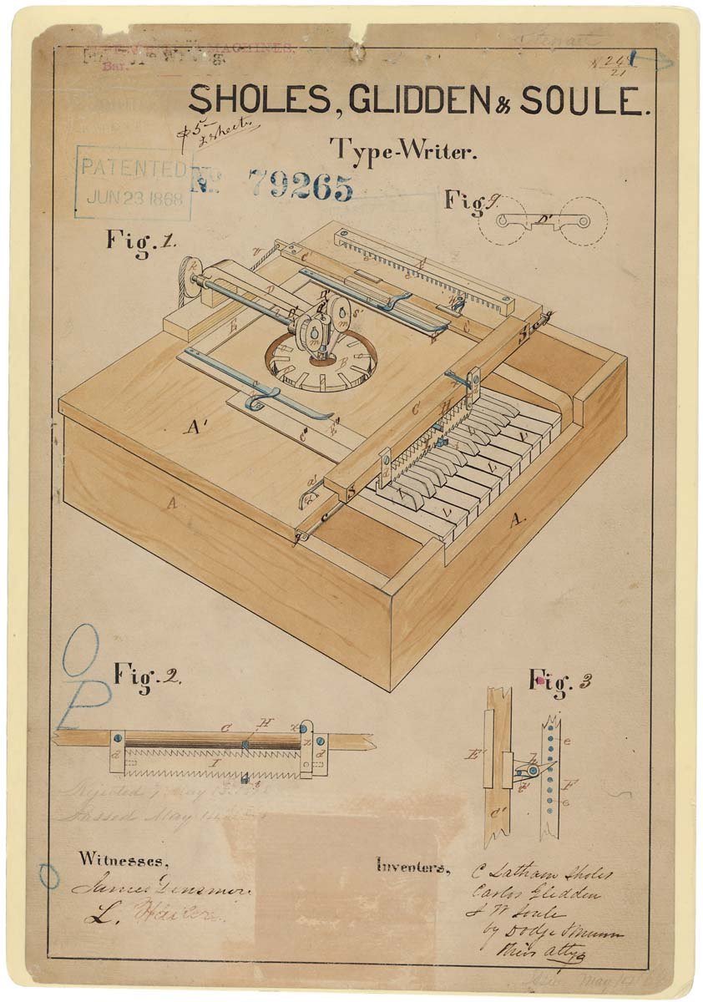
1868 – Sholes, Glidden & Soule
Notes:
resembled "a cross between a piano and a kitchen table"
Only 15 units produced before they ran out of money.

Slide 3
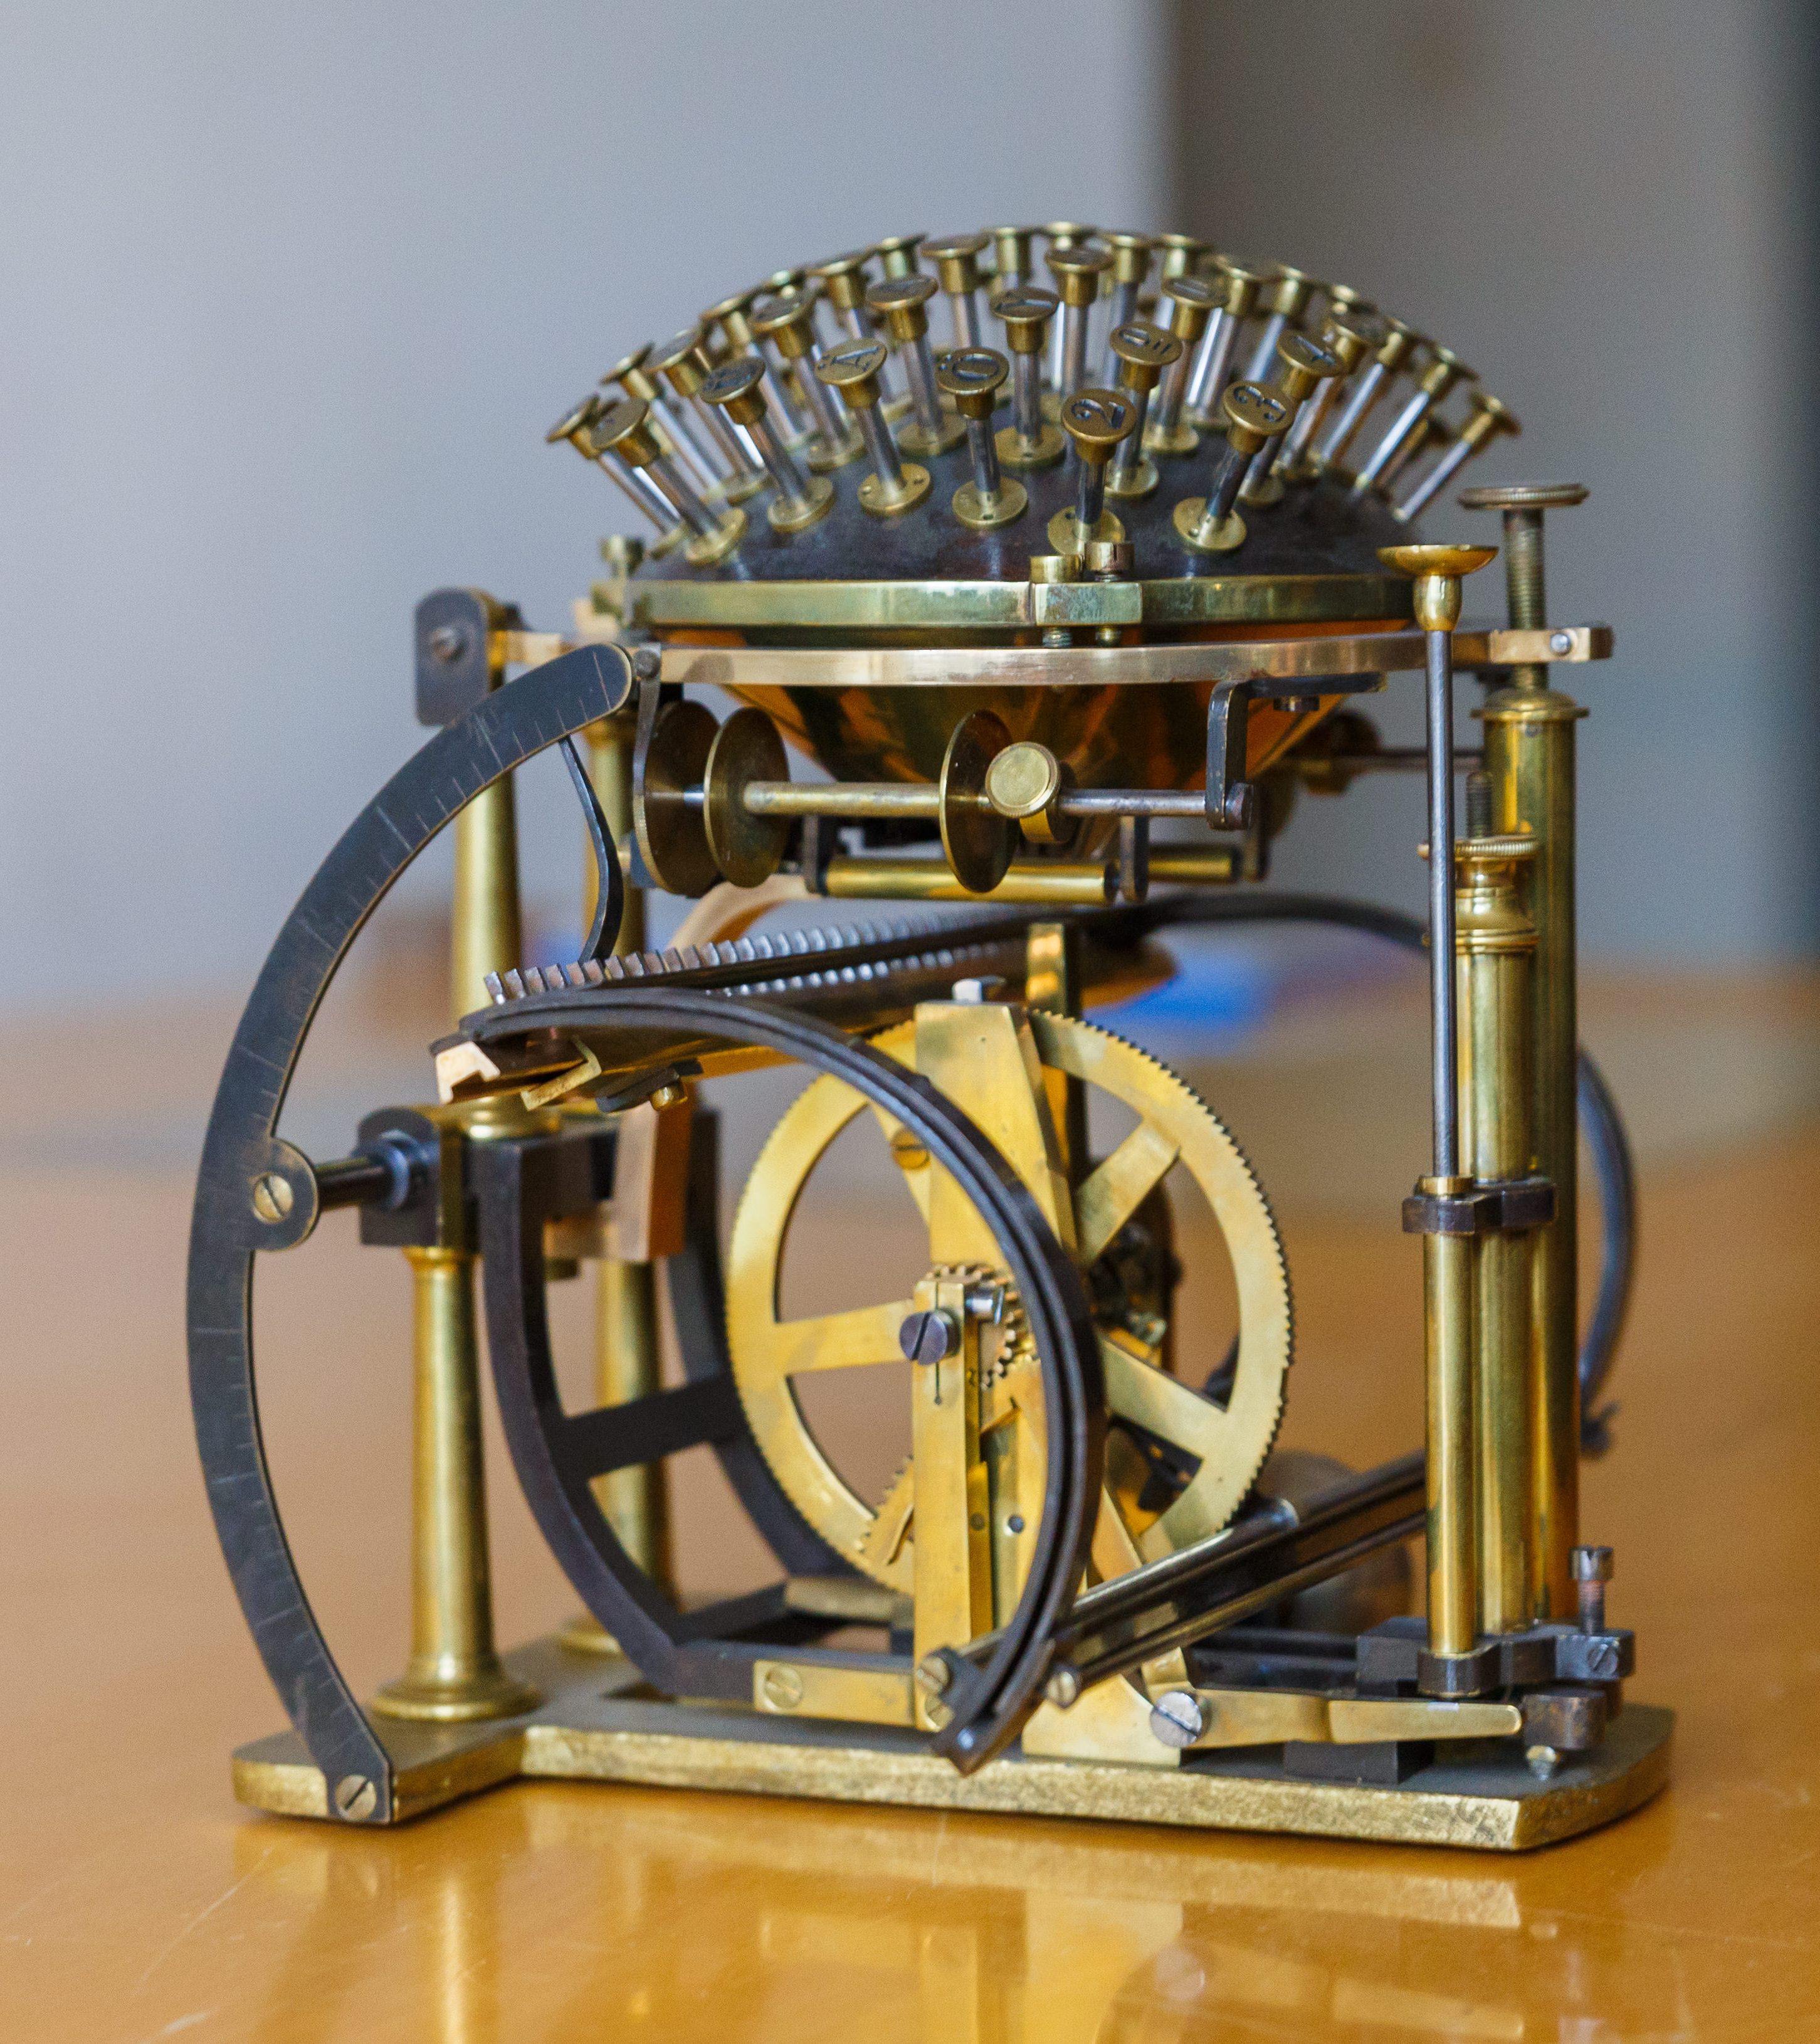
1870 – HansenWriting ball
Notes:
Combination of unusual design and ergonomic innovations.
52 keys on a brass hemisphere
Letters placed for quickest writing speeds
Superior to other typewriters of the time, but was never really successful

Slide 4
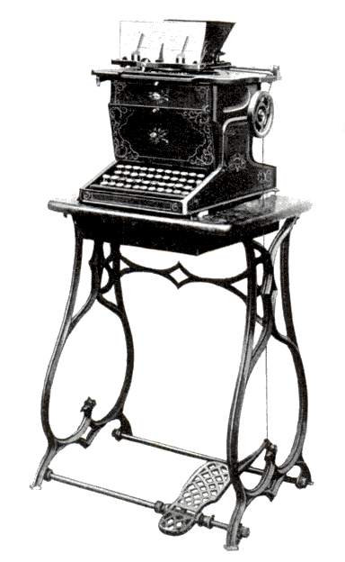
1874 - S&G Remington No.1
Notes:
The first commercially successful typewriter
After several short-lived attempts to manufacture the device, the machine was acquired by E. Remington and Sons in early 1873.
During its development, the typewriter evolved from a crude curiosity into a practical device, the basic form of which became the industry standard.
This introduced a four-rowed QWERTY keyboard. Several design deficiencies remained, however. The Sholes and Glidden could print only upper-case letters and was a "blind writer", meaning the typist could not see what was being written as it was entered.

Slide 5

1878 - Remington No.2
Notes:
The first typewriter to be produced in great quantity.
It was first typewriter to have a shift key, giving two characters for each key.
It was only with the emergence of front-strike visible typewriters, the first being the Daugherty (1893) and most importantly the Underwood (1896), that the understrike machines would finally loose their market command and would cease to be manufactured shortly into the new century.

Slide 6
By 1878 we had
QWERTY Layout
Shift key
Staggered columns
Notes:
Staggered columns was also because of the design where each key was attached to a type arm that actuated the type hammer.
Contrary to popular belief, QWERTY was not invented to slow you down, but rather to make it highly unlikely that you would strike two keys next to each other in quick succession.

Slide 7
Fast forward (nearly) 100 years
Notes:
Nearly a century before something interesting happens

Slide 8
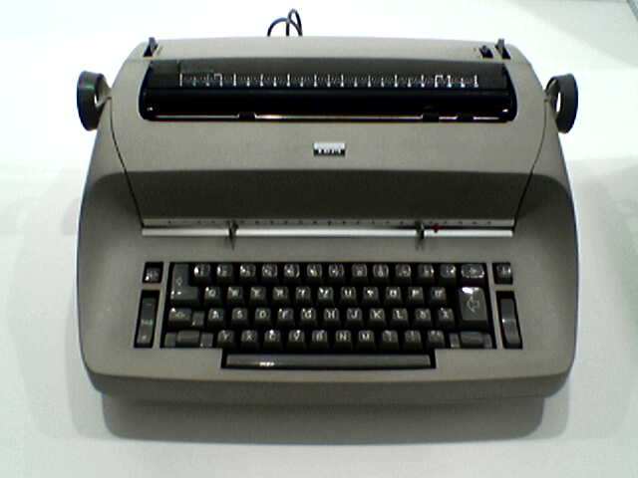
1961 – IBM Selectric
Notes:
Faster and more reliable, but still QWERTY layout.
This was actually converted and used as a terminal on some mainframe machines.

Slide 9
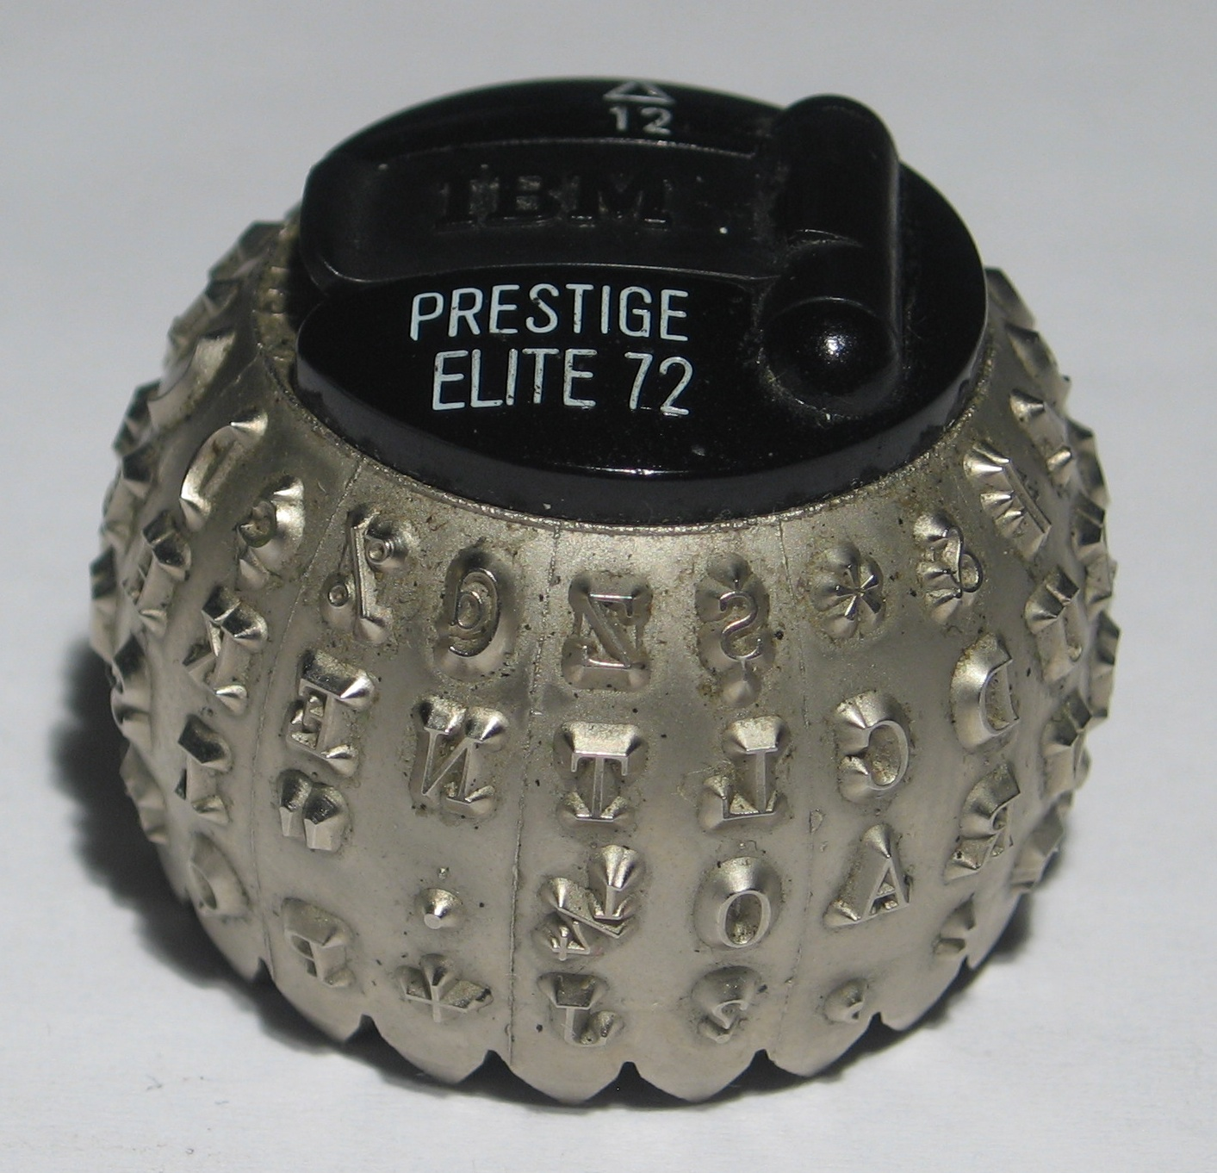
1961 – IBM Selectric
Notes:
Instead of the "basket" of individual typebars that swung up to strike the ribbon and page in a traditional typewriter, the Selectric had a type element (frequently called a "typeball", or more informally, a "golf ball") that rotated and pivoted to the correct position before striking.
This made it possible to replace just the type element to get different fonts.

Slide 10
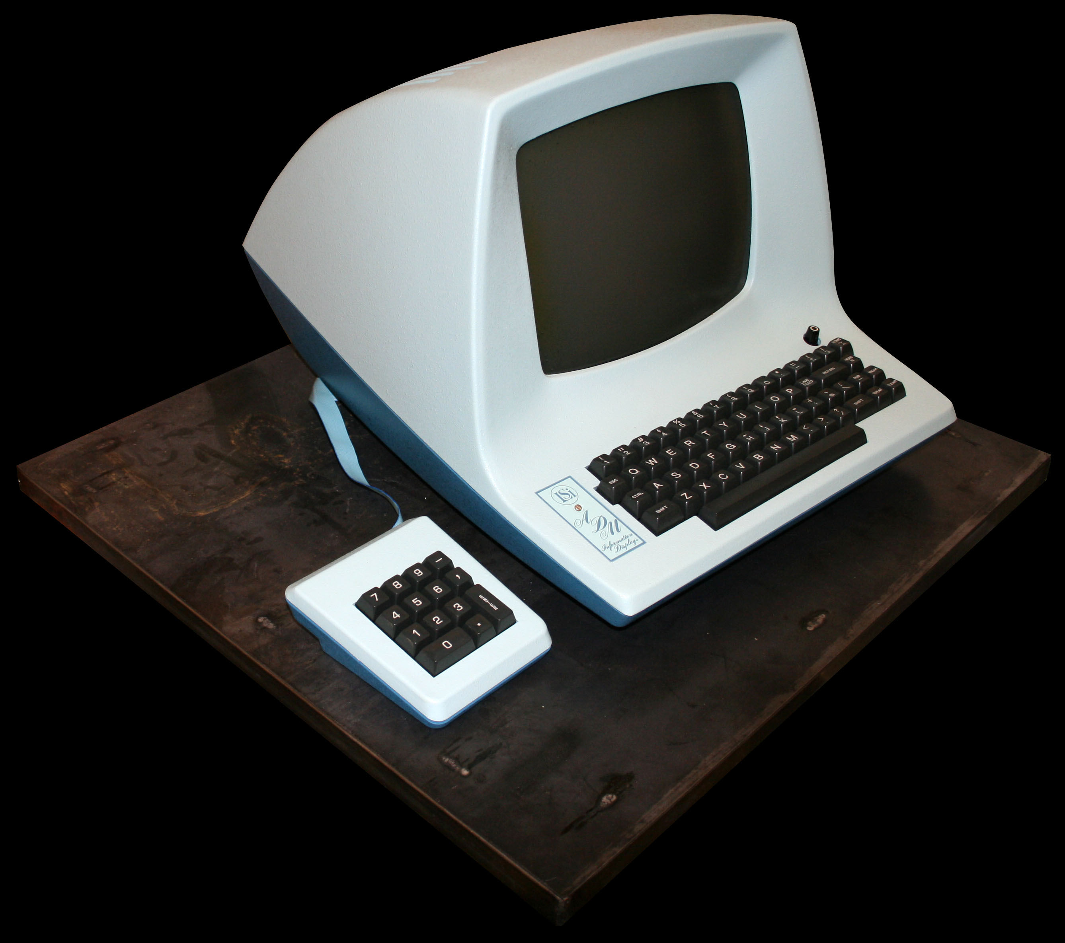
1974 – ADM-3A
Notes:
The ADM-3A was one of the first video display terms. Had a 12 inch screen displaying 12 or 24 lines of 80 characters.

Slide 11
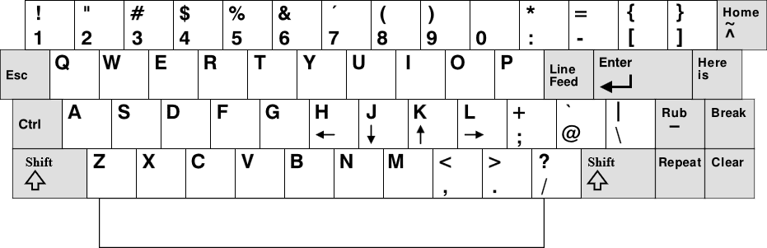
1974 – ADM-3A
Notes:
VI written on this keyboard.
CTRL, ESC, arrows on HJKL,
: on unshifted layer,
~ / HOME key. Why home is ~.

Slide 12
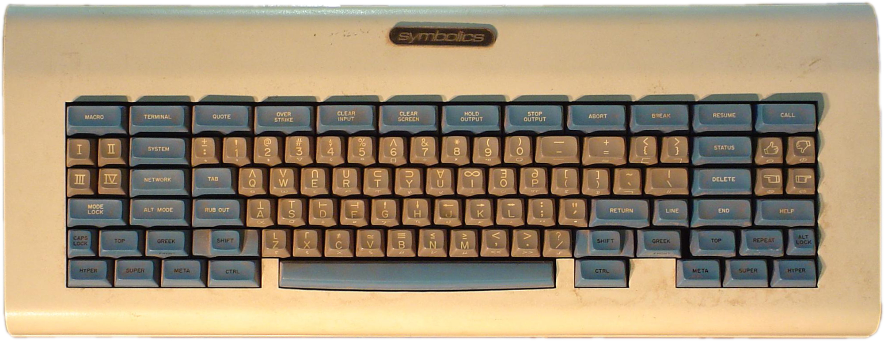
1974 – Symbolics “Space Cadet”
Notes:
Influenced emacs.
HYPER, SUPER, META and CTRL modifiers.

Slide 13
1977
Things finally change

Slide 14
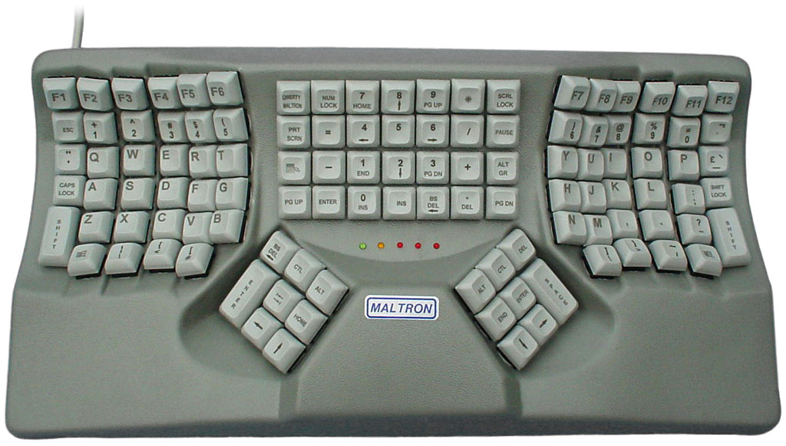
1977 - Maltron
Notes:
Founded by South African-born inventor Lillian Malt
Designed for speed and comfort. Standards for ergonomics today still.
Thumb clusters, split key wells. Columns not staggered. Keys at different resting heights. New layout optimised for English.
Despite it’s innovations, was never successful because it was just to expensive to manufacture.
Took another 15 years before somebody could find a way to manufacture it in a cost effective way.

Slide 15
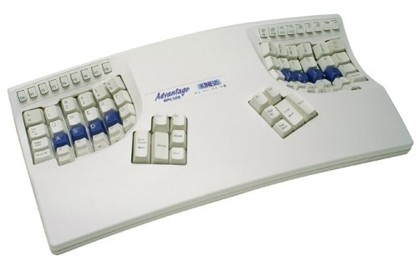
1992 – Kinesis Model 100
Notes:
The Model 100 was the first production-model ergonomic keyboard in the United States which was based on a traditional letter layout.
Patented new manufacturing techniques had to be developed to facilitate the manufacturing process for a keyboard which lacked any significant flat surface!
Kinesis has pioneered other products, including the first general purpose foot switches supplementing keyboard input,

Slide 16

2017 – What are you typing on?
Notes:
20 years later – Keyboards must be exciting right?

Slide 17
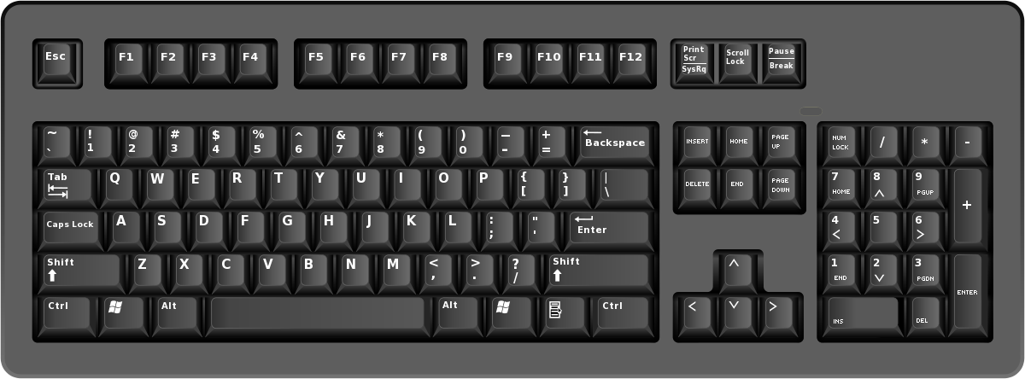
2017 – What are you typing on?
Notes:
If you work for a corporate, it’s probably one of these

Slide 18
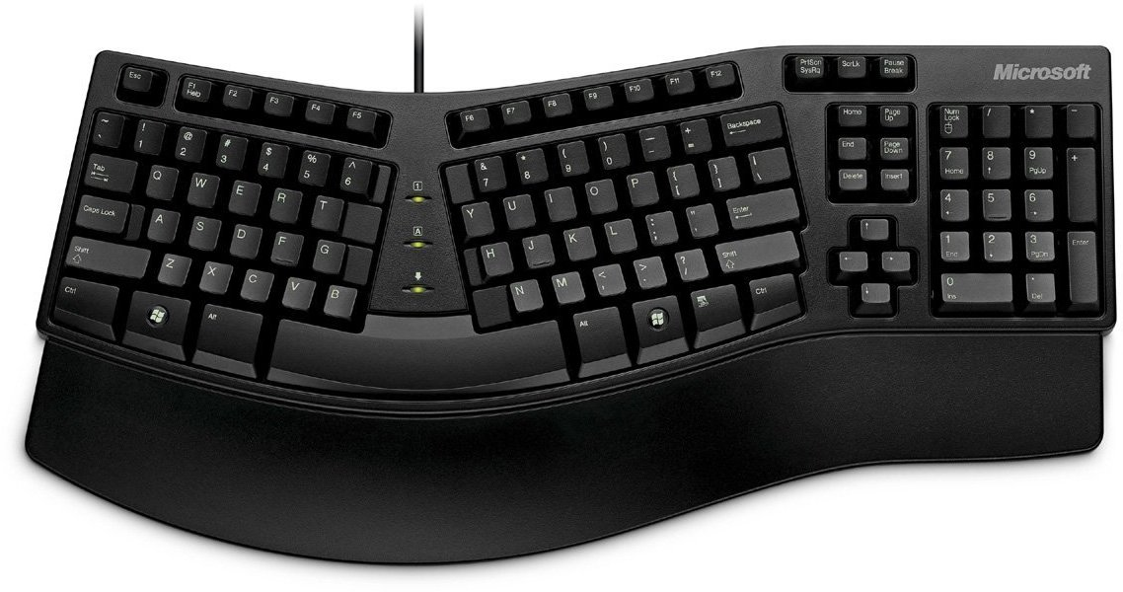
2017 – What are you typing on?
Notes:
If you’re lucky, maybe something like this.

Slide 19
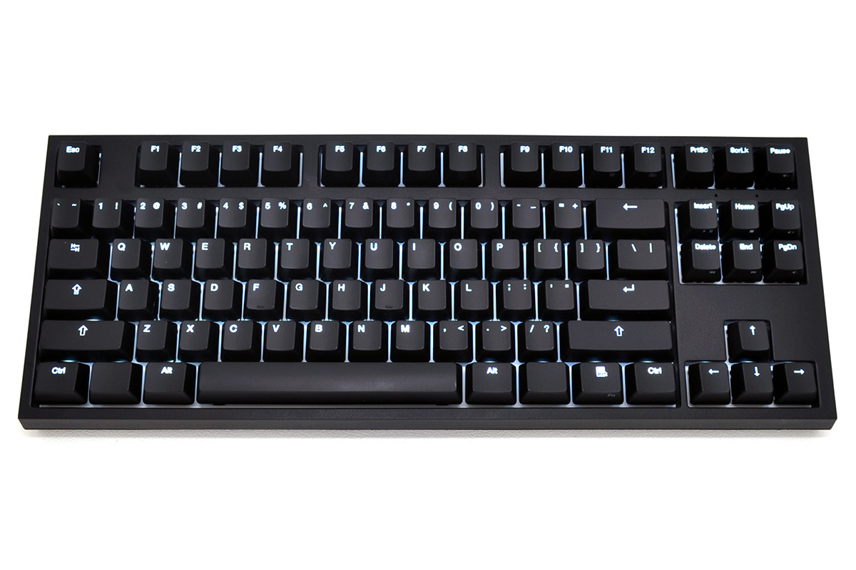
2017 – What are you typing on?
Notes:
Or if you bought your own, probably one of these?

Slide 20
Why do we care about any of this?
Notes:
Before we look at some better alternatives, it feels like a good time to consider why this is important.

Slide 21
RSI
An umbrella term for a variety of pain in muscles, tendons and nerves.
Not a small issue. In 1996 was already costing US companies more than $20 billion a year
Notes:
It primarily consists of micro-injuries of forearm tissue
an accurate diagnosis is difficult, because sufferers are often affected by more than one disease and those micro-injuries cannot be detected with imaging techniques such as X-rays or MRI scans.
In addition, the individual problems are often not very pronounced, but jointly cause the pain.
"Occupational Safety and Health Administration" (OSHA) (which is an agency of the United States Department of Labor) already stated in 1996 that "One in every three workers' compensation dollars pays for RSIs.
In all, insurers awarded an estimated 2.73 million workers' compensation claims for RSIs in 1993, costing employers more than $20 billion. Indirect costs is estimated at $100 billion.

Slide 22
Causes of RSI
Repetitive movements performed over a longer period of time.
Notes:
We often think it is something that plagues office workers
Actually documented in medical literature in the 1700’s in industrial workers

Slide 23
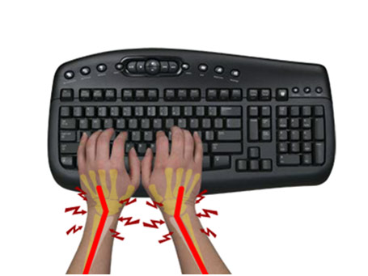
Ulnar deviation
Notes:
Ulnar deviation occurs when your wrist is bent outward in the direction of your little finger.
On traditional keyboards the span of your shoulders exceeds the contiguous width of the home row of keys. In order to position your hands over the home row it is necessary to bring your hands together in front of your body with your wrists deviated.
This constricts the blood flow through your wrist and also requires sustained muscle tension which further reduces blood flow to the muscles.
The median nerve runs through the carpal tunnel in your wrist, ulnar deviation reduces the size of the carpal tunnel and pressure on this nerve.
Ulnar deviation is among the most common and potentially damaging keyboard postures.

Slide 24

Avoiding ulnar deviation
Notes:
You can avoid ulnar deviation in either of two ways:
Angled halves greatly reducing ulnar deviation by placing your wrists in a more neutral position;
Complete separation – by separating the two halves of a keyboard you can accomodate a wide-range of shoulder widths while at the same time promoting neutral wrist posture.

Slide 25
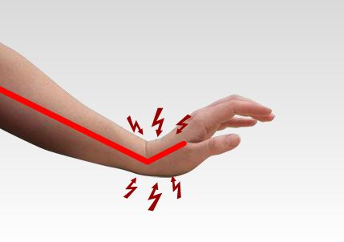
Wrist extension
Notes:
With wrist extension, your wrists are bent up and back such that the fingers are higher than the wrist joint.
This greatly reduces blood circulation through the wrist and hand and can quickly cause pain, fatigue and numbness.
Most traditional including many ergonomic keyboards have a positive 10 degree slope from front to back that promote wrist extension.

Slide 26

Avoiding wrist extension
Notes:
In order to reduce/eliminate wrist extension your keyboard should have a zero degree slope from front to back.
Additionally, padded palm supports can help to position your wrist in a completely neutral position – at the same elevation as your forearm and hand.

Slide 27
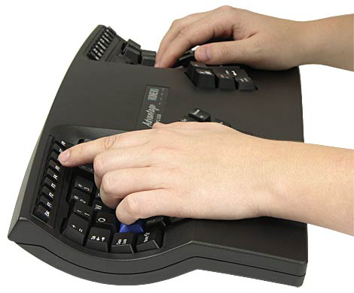
Avoiding wrist extension

Slide 28
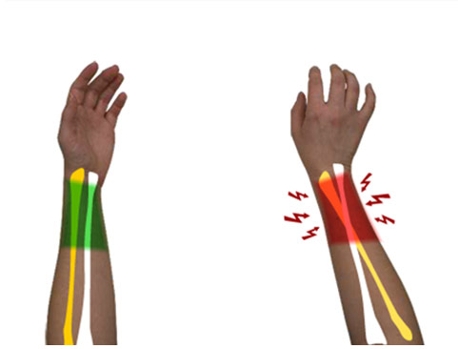
Wrist pronation
Notes:
Pronation in the forearm and wrist occur in a typing position as the palms of your hand are turned face down and is parallel with the flat surface of the desk or floor.
The majority of this turning involves the rotation of both forearm bones (the ulna and radius).
Sustained pronation increases pressure on the forearm muscles and surrounding tissues and reduces blood circulation which can lead to fatigue and injury.
Research demonstrates that a moderate elevation of the thumb side of the hand dramatically reduces this type of stress.

Slide 29

Avoiding wrist pronation
Notes:
Unlike traditional flat keyboards that force your forearms and wrists into pronation, split keyboards can have accessories that provide variable and reproducible tent settings to greatly reduce pronation.

Slide 30
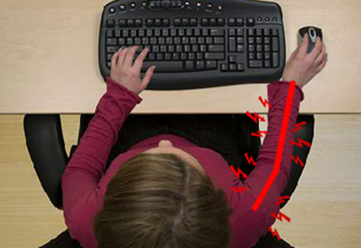
Arm and shoulder over extension
Notes:
Most traditional and many ergonomic keyboards have an integrated numeric 10-key which increases the overall length of the keyboard.
This can force the user to over extend both their forearm and shoulder while reaching for the mouse which can lead to neck, shoulder and forearm strain.

Slide 31
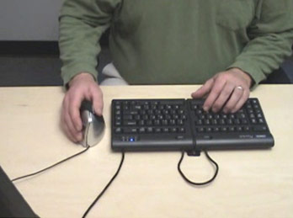
Avoiding over extension
Notes:
Smaller keyboards also addresses this problem by embedding the numeric keypad in one of the keyboard halves
This allows close placement of any pointing device, thereby, reducing over-reach issues.

Slide 32
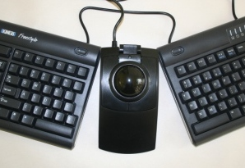
Avoiding over extension
Notes:
Another solution for over reaching is to use a trackball between the two halves of a split keyboard.
This has the added benefit of putting your pointing device in reach of both hands so you can alternate hands to give your dominant hand a break.

Slide 33
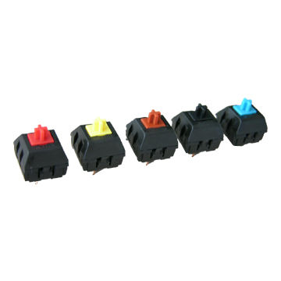
Mechanical keys
Notes:
I find mechanical keys easier to type on.
Lots of anecdotal evidence, but no real proof that it improves RSI.

Slide 34
How do we improve on this

Slide 35
Wishlist
Split keyboard / Wide keyboard
Smaller keyboard
No slope from back to front
Palm rests
Tenting (Adjustable)
Mechanical switches

Slide 36
Commercial options
Notes:
Let’s look at some commercial options

Slide 37

Zalman K500
Notes:
Cheap Chinese knockoff switches – will fail in a year or two
Might be a good option if you are unsure about mechanical keys
Cost about $60

Slide 38
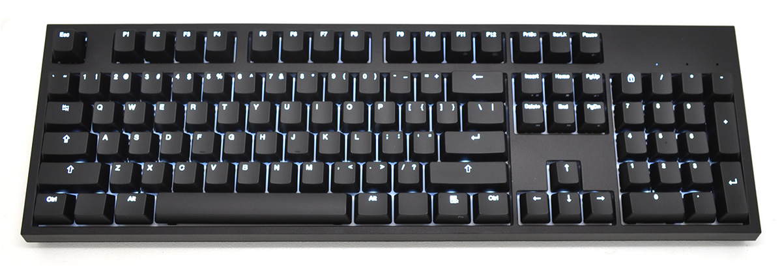
Code keyboard
Notes:
Very popular among everybody that tries it
Very configurable, Can choose switch colors
87 and 104 key versions
Ranges from $140 to $165 depending on switches
Not ergonomic at all

Slide 39
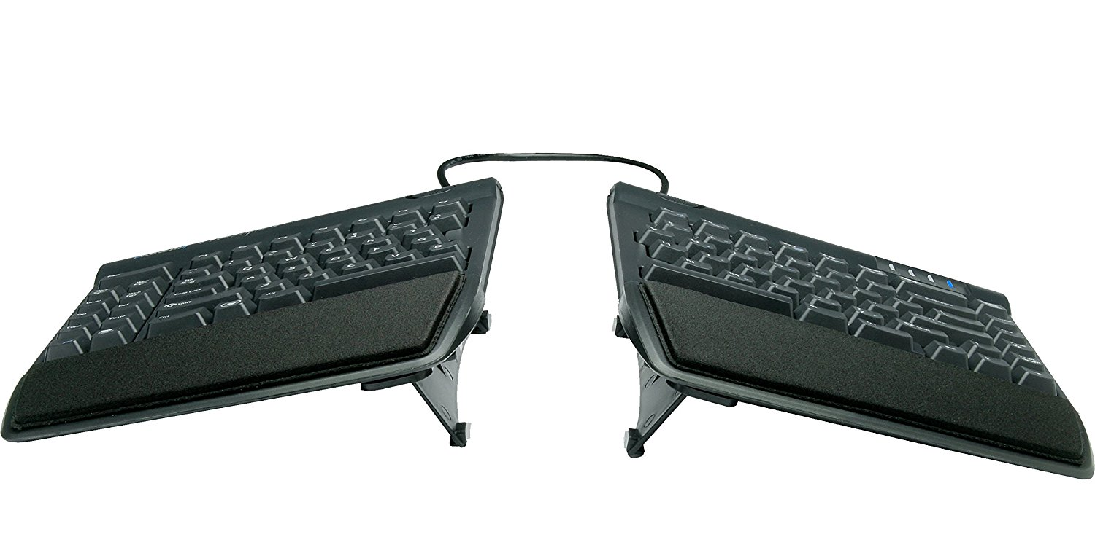
Kinesis Freestyle2 with VIP3 Lifters
Notes:
Lifters can let you tent at 5, 10 and 15 degrees
Can be separated by up to about 22cm (version with up to 50cm available)
Includes padded palm rests
Lower force key switches – not mechanical. Coming sometime this year
Mostly happy customers if you look at the reviews
Cost about $135

Slide 40
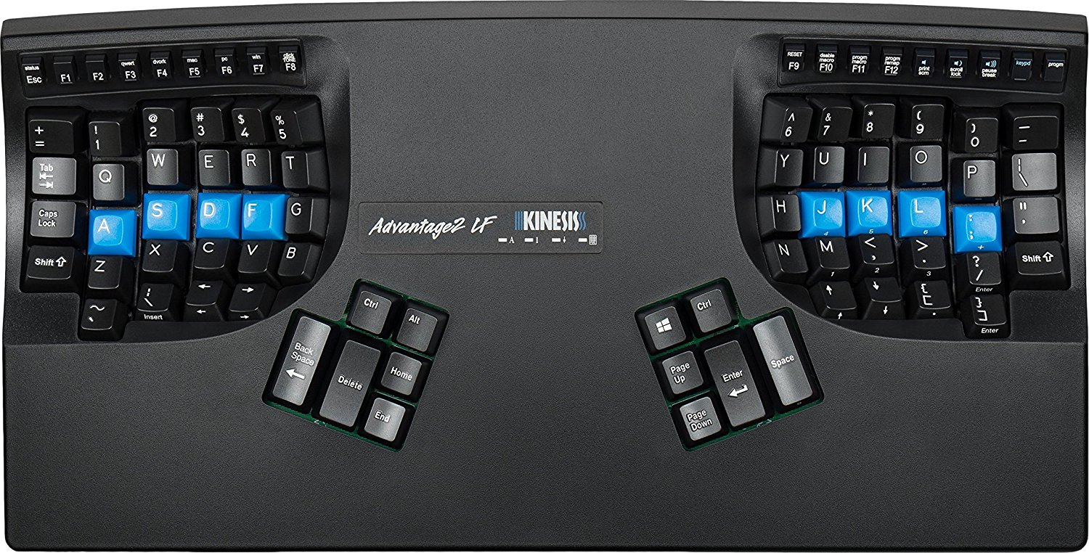
Kinesis Advantage2
Notes:
Cherry MX Brown switches
Very good reviews, but a sizable investment
Cost about $320

Slide 41
DIY Kits

Slide 42
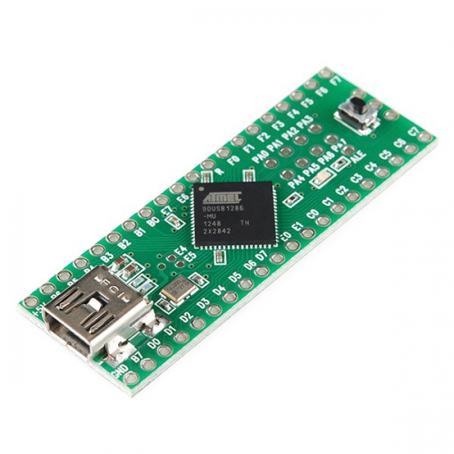


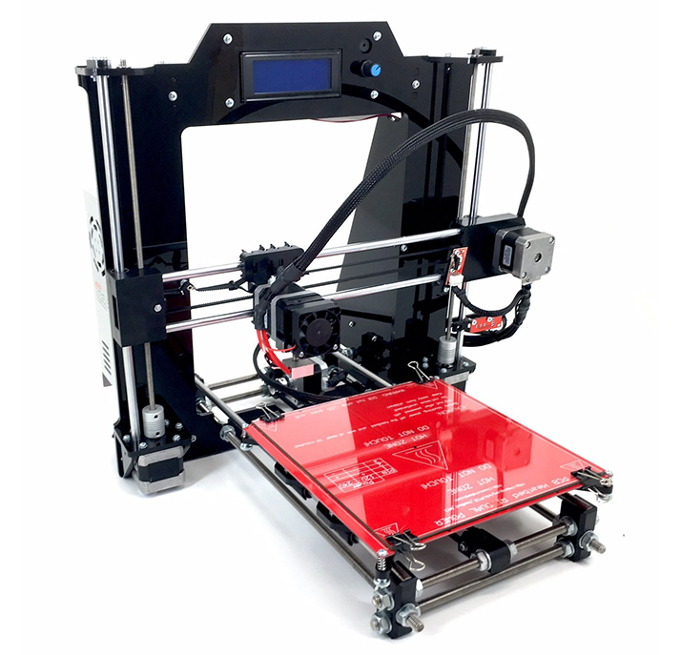

Slide 43
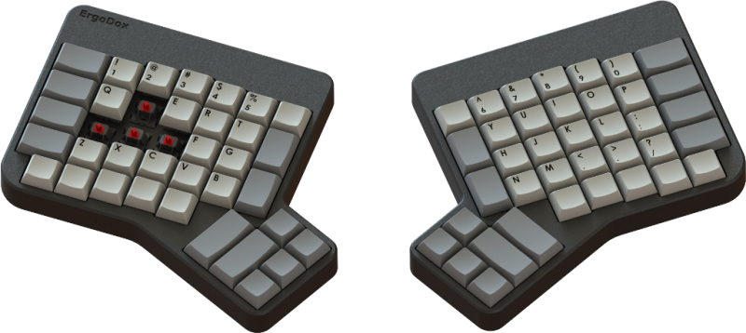
2011 – Ergodox
Notes:
Split keyboard, mechanical switches and columns not staggered. Originally with 3D printed case, but now has much cheaper laser cut case.
Also has thumb clusters – most people find them uncomfortable. No tenting on original version.
$199 for kit from massdrop.com

Slide 44
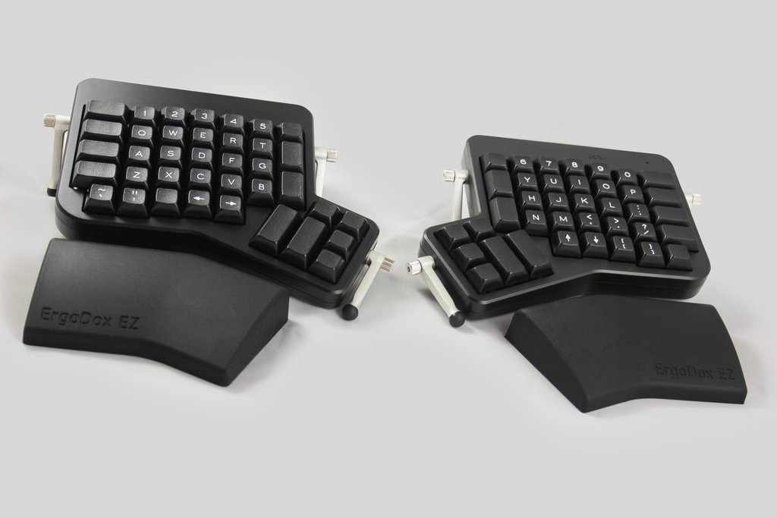
2017 – Ergodox EZ
Notes:
Fully assembled version with adjustable legs to change tilt / tent
Comes with palm rests
$295 for assembled version.

Slide 45
Building your own

Slide 46
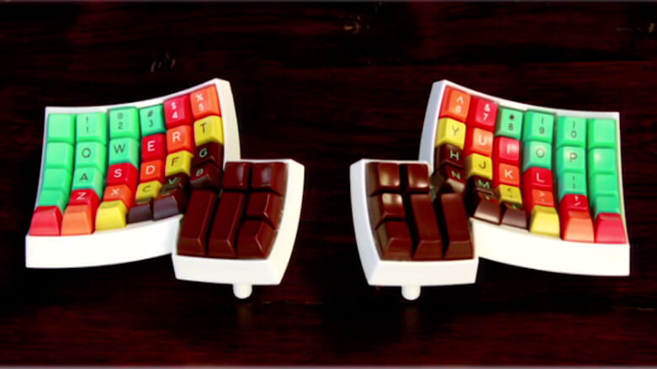
Dactyl keyboard
Notes:
The Dactyl is a parameterized, split-hand, concave, columnar, ergonomic keyboard.
Case generated from Clojure script, so can be tweaked for your hands. Case pretty expensive to have printed and hard to print yourself.
Not an easy keyboard to build…
So I decided to build one.

Slide 47
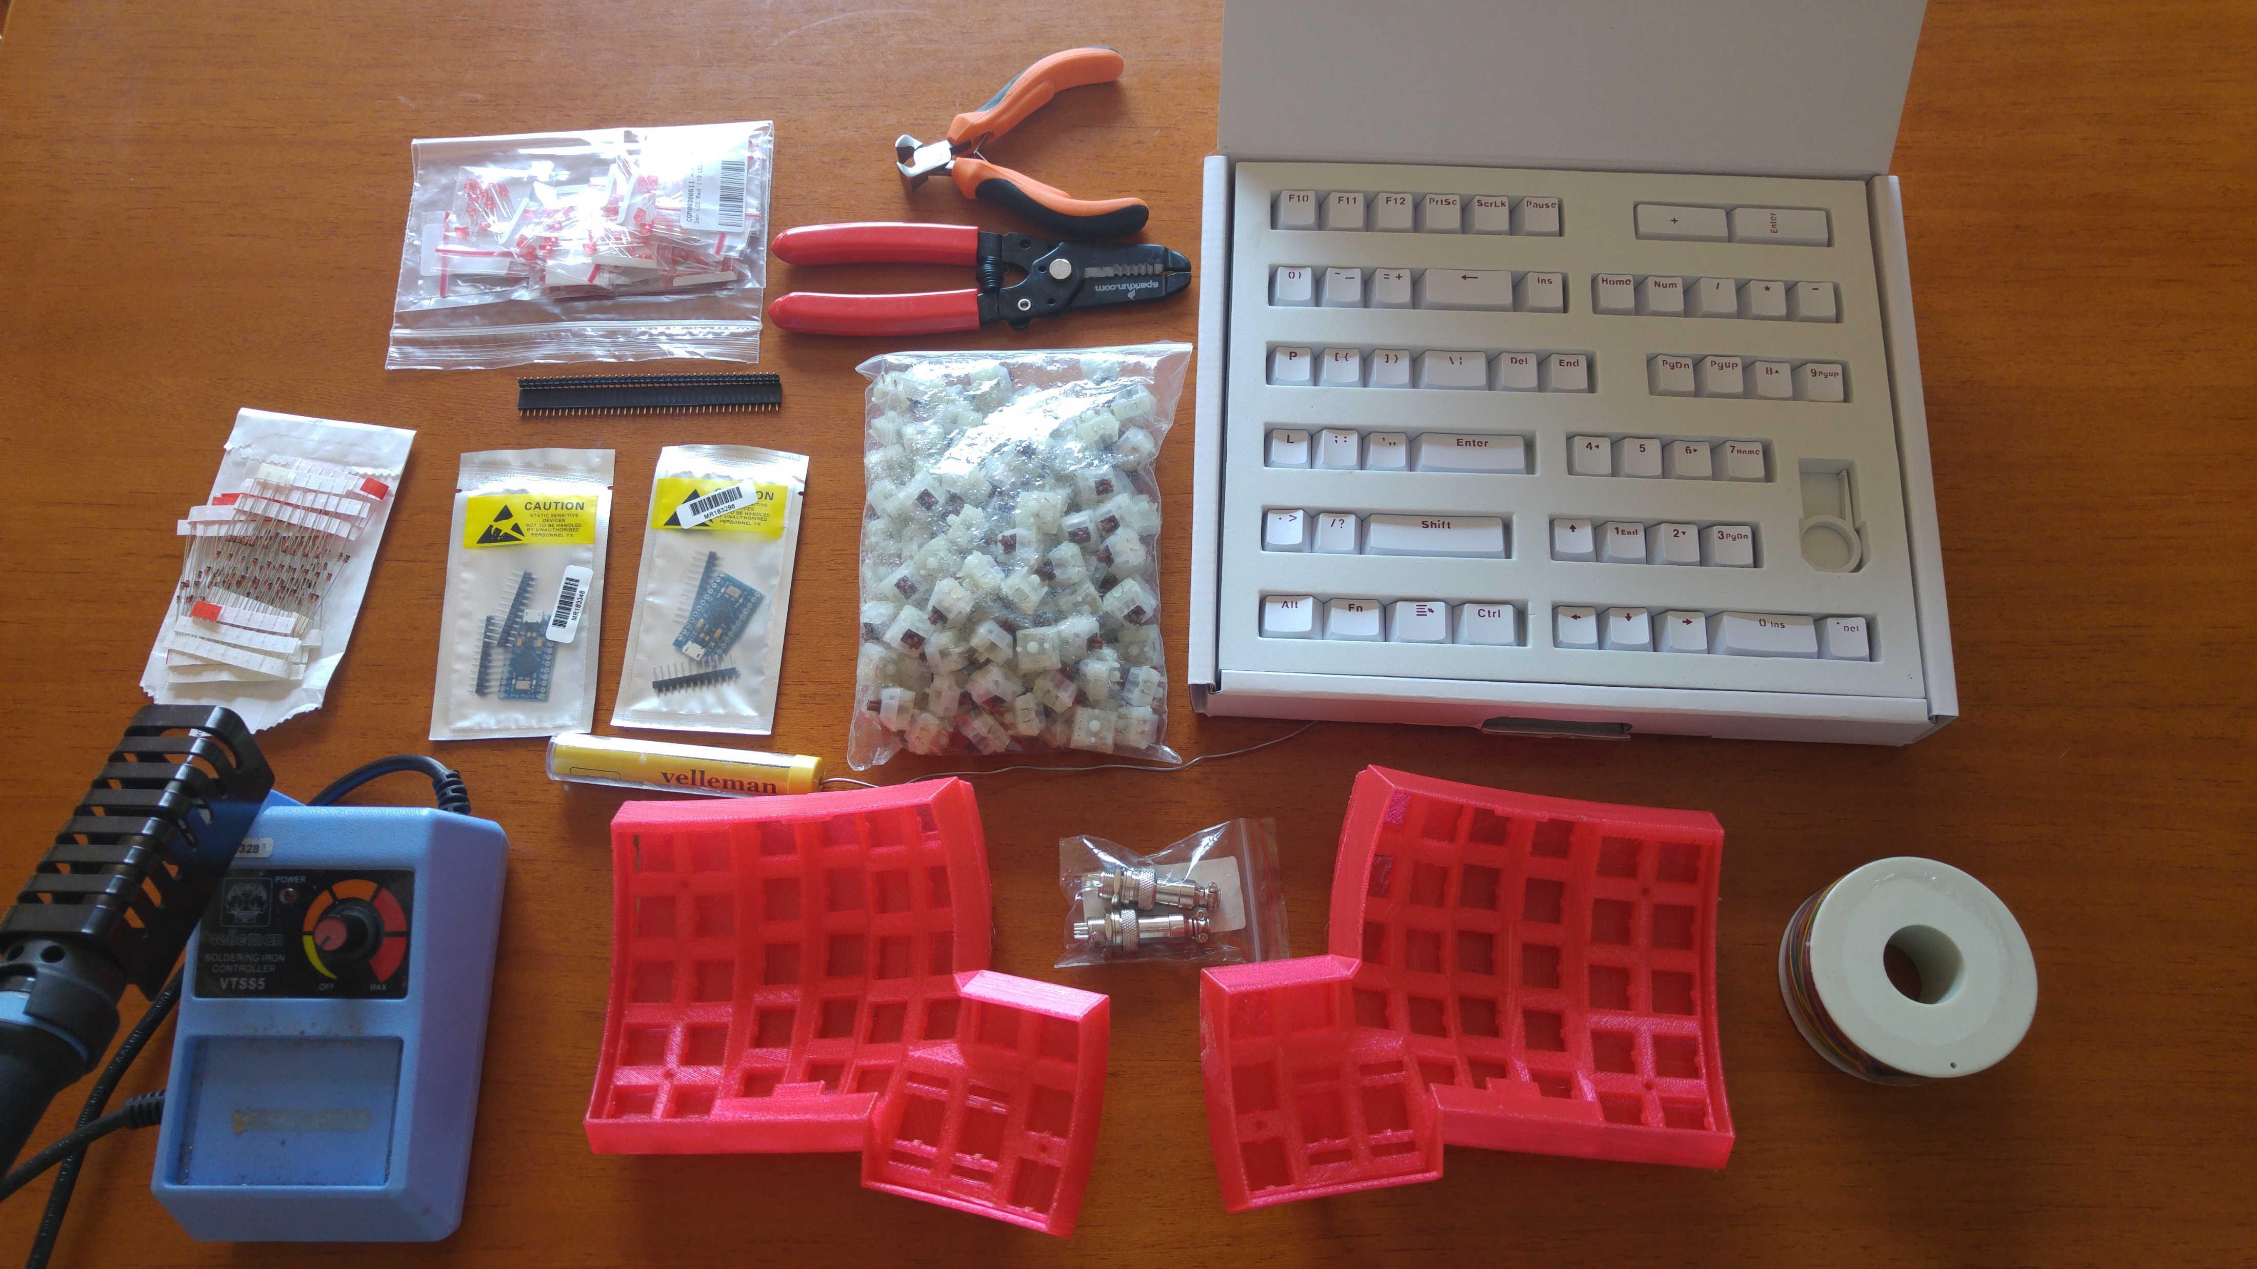
Dactyl keyboard – parts needed
Notes:
The Dactyl is a parameterized, split-hand, concave, columnar, ergonomic keyboard.
Case generated from Clojure script, so can be tweaked for your hands. Case pretty expensive to have printed and hard to print yourself.
Not an easy keyboard to build…
So I decided to build one.

Slide 48
Cost of building your own
Case: R850
Switches: R1000 (About $1 each)
Keycaps: R650+
Controllers: R550+
Misc: R250 (Diodes, wire, connectors, solder, etc)
Total: R3300
Notes:
And countless hours.
PCB’s will add another several hundred, but will knock off some time.

Slide 49
Who should build their own
Nobody
People interested in both keyboards and making stuff
People looking for something unique
Notes:
Nearly always going to be more effort and cost to build your own.

Slide 50
Where does this leave us?
Notes:
Many better options
Lots of keyboards that help us avoid some issues
Still hard to find keyboards that avoid wrist extension and pronation
Lots of keyboards that try to deal with radial and ulnar deviation, but unless split, they cater for the average person

Slide 51
What should you take away from this
Notes:
Most of you won’t build your own
A lot of you won’t even buy a better keyboard
Prevention really is better than cure here. Once you feel pain, it is too late to fix easily
All I ask is that you consider the causes of RSI when choosing or even using a keyboard

Slide 52
Questions

